Slide 1
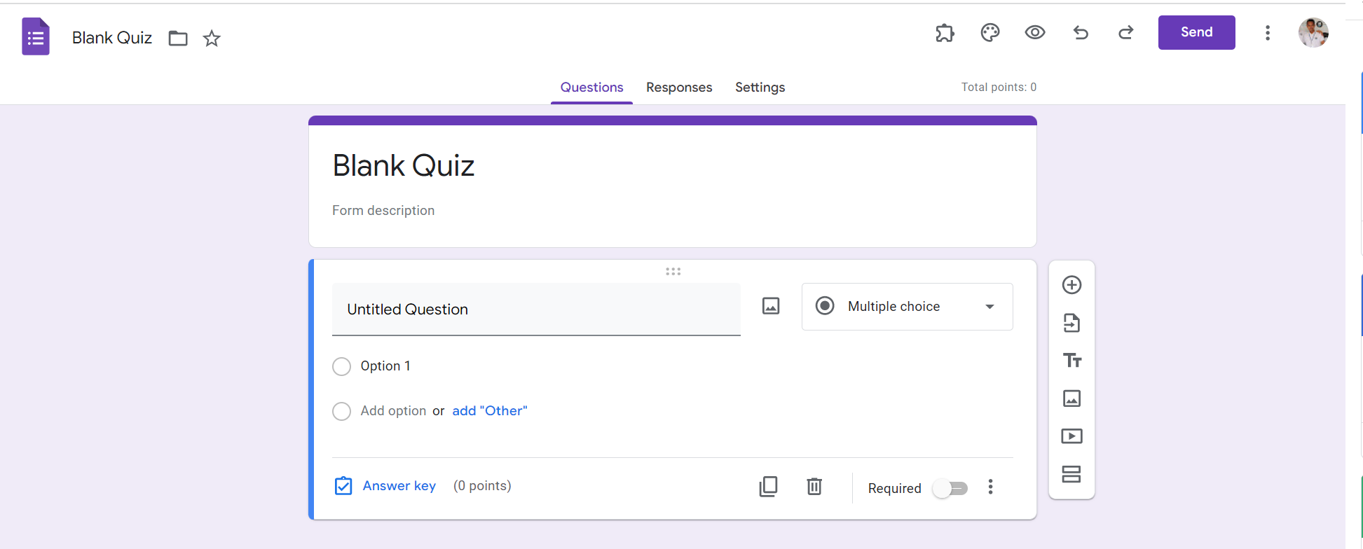
Identify root components of website below

Slide 2
Nav
Header
Container

Slide 3
Navigation
Nav-top
Nav-bottom

Slide 4
Nav-top
Div1
Div 2
Nav-left
Nav-right
Nav-bottom

Slide 5
Div1
Div2
icon
text
icon
icon
icon
icon
icon
icon
icon
button
icon
icon

Slide 6
button
button
button
button
Nav-left
Nav-right

Slide 7

Div
Display: flex;
Flex-direction: column
Text
Text

Slide 8
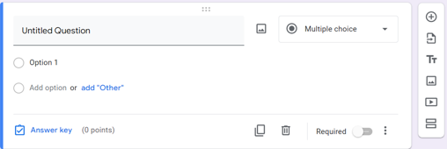
Container-left
Container-right

Slide 9
Div1
Container-right
Div2
Div1

Slide 10
icon
Content-top
Content-bottom
icon
text
text
text
text
text
text

Slide 11
icon
icon
icon
icon
icon
icon

